Slide 1
Capital Coast PDRP
Electronic PDRP Competent
Peer Assessor
Nurse Coordinator Professional Development

Slide 2
Introduction Guide to PDRP Healthcare
E-portfolio

Slide 3
This guide is intended to support peer assessors to complete a peer assessment using the healthcare e-portfolio system, this includes:
  Step-by-step guide on how to access the shared e-portfolio
  Expectations of a peer assessor
  Sharing your peer assessment
  How to request for additional information from the portfolio holder if required

Slide 4
What is the PDRP?
  Professional Development Recognition Programme.
  The PDRP is a recertification programme for NCNZ.
  Supports practice development and career progression.
  It is as expectation for all nurses to participate in the PDRP.
  All applications for funding require a current PDRP.
  Requirement for NETP/NESP nurses to successfully complete programme requirements.

Slide 5
Peer Assessment Requirements
  The peer assessment is done by, or delegated by, the manager.
  The peer assessor must be on the same or higher level on the PDRP or a Senior Nurse
  As a peer assessor you must provide examples of how the nurses practice meets one of the indicators under each competency
  Peer assessors should also check all portfolio pages to ensure all requirements are included before the portfolio is sent to the manager for final verification and endorsement.

Slide 6
Introduction to PDRP healthcare e-portfolio
At Capital and Coast currently the PDRP portfolio system is paper based.
The aim is to shift towards an electronic portfolio system for all levels on the PDRP – currently only NETP and NESP are able to complete the PDRP using Healthcare e-portfolio.
A Healthcare e-Portfolio is an electronic PDRP portfolio system.

Slide 7
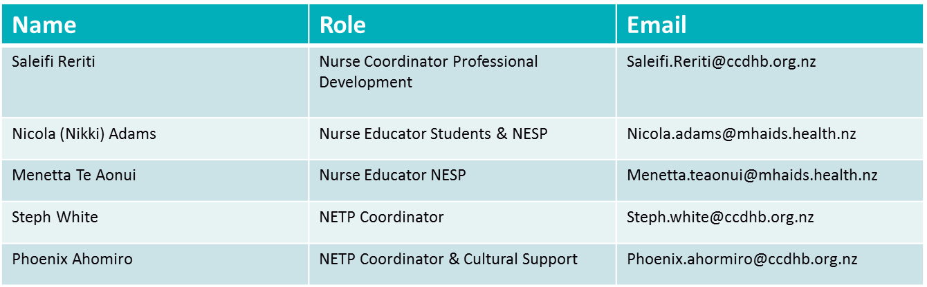
Key contacts for healthcare e-portfolio
If you have any technical difficulties accessing the ePDRP please contact Sara. If there are other issues outside of this please contact the Programme Educators/Coordinators to discuss further.
Sara Robinson
Sara.Robinson@ccdhb.org.nz

Slide 8
Quick Peer Assessment Recap
3.1 Establishes, maintains and concludes therapeutic interpersonal relationships with health consumers.
Indicator A: Initiates, maintains and concludes therapeutic interpersonal interactions with health consumers.
A: Nurse X initiates, maintains and concludes therapeutic interpersonal interactions with our health consumers on a daily basis
A: Nurse X initiates therapeutic relationships within our unit and he maintains therapeutic relationships during his shifts. He will always conclude the therapeutic interpersonal interactions at the end of the day.
A: Nurse X initiates, maintains and concludes therapeutic relationships within our unit. I have observed him introducing him self to a client, explaining his role in their care, asking what the client’s preferred name. He maintained this therapeutic relationship by developing a care plan in partnership with the client and concluded this therapeutic relationship by saying goodbye to the client and handing his care over to the PM shift nurse.

Slide 9
Healthcare e-portfolio Requirements
Competent portfolio requirements
There are 9 pages:
  Portfolio completion page
  Introduction & Declaration
  Curriculum Vitae (Optional)
  Continuing Professional Development Record
  Domain one: Professional Responsibility
  Domain two: Nursing Management
  Domain Three: Interpersonal Relationships
  Domain four: Interprofessional health care and quality improvement
  Professional Development & Career Plan and NETP mid year appraisal

Slide 10
Important information
This is a guide only intended to support you to:
Healthcare e-Portfolios are only accessed by logging into your connect me account via Chrome or clicking on the connect me icon and ensuring the page opens up via chrome (internet explorer does not support healthcare e-Portfolios therefore you will have difficulties completing the ePDRP).
To help you complete e-Portfolio requirements for the peer assessment, there are instructions on all pages in healthcare portfolio to assist you with what you need to complete and how to complete it. It is important that you read all instructions to support the completion of the Competent e-portfolio.

Slide 11
How to access the shared e-portfolio as the Peer Assessor

Slide 12
Accessing the shared e-portfolio
You will receive an email to your work email address from Healthcare portfolio – this email will state that you have been given access to RN Competent Portfolio – “Green Smith” 2023
Please do not click on the link to access the portfolios as the link does not give you access you need to login to connect me to access e-portfolios– see the next steps for access.

Slide 13

Step 1
If accessing the ePDRP from the intranet/Citrix (hospital staff):
Click on the ConnectMe icon
If accessing the ePDRP from home (and/or non-hospital people):
Open chrome google CCDHB ConnectMe and click the link. Click ConnectMe login
You can only access Healthcare e-Portfolios by logging into connect me via Chrome (internet explorer does not support healthcare e-Portfolios to make editing changes when adding your work )

Slide 14
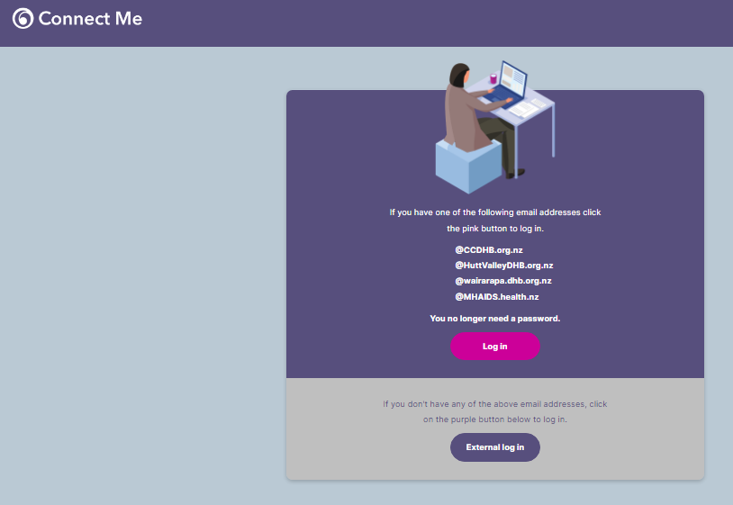
Step 2
Log into your Connect me account
If you do not know your username or password follow the prompts on the screen or you will need to get in touch with connect me for support

Slide 15
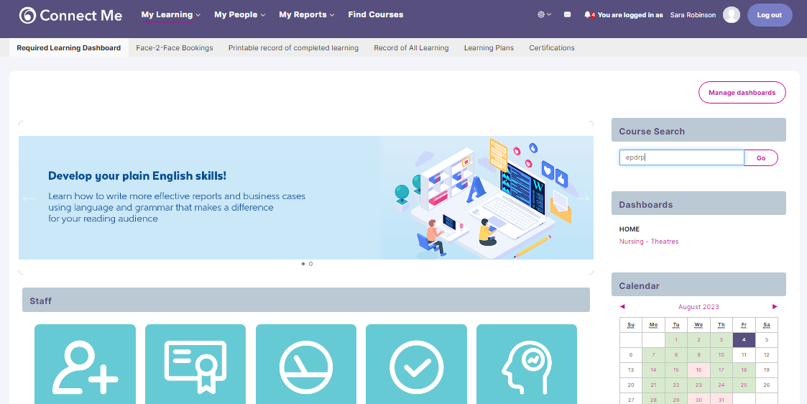
Step 3
On the connect me homepage
In the search bar (right side of page) - search ‘ePDRP’ and click Go

Slide 16
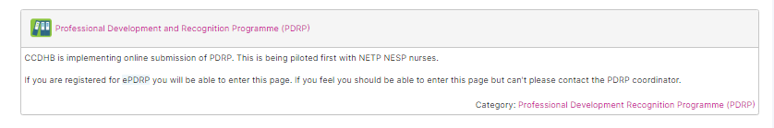
Step 4
click on the course ‘Professional Development and Recognition Programme’
You have all been give access to this course page however if you cannot click into the course page please contact Saleifi to approve access.

Slide 17
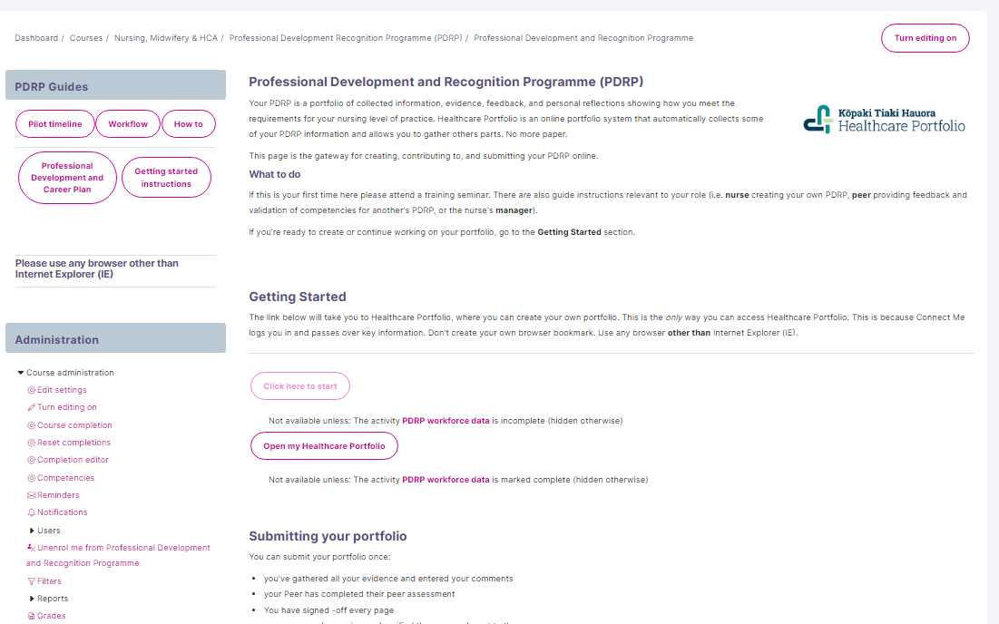
Step 5
You should end up on this page to start accessing Healthcare e-Portfolio
Read all information and follow the prompts to access Healthcare e-Portfolio
Once you have read the information, under the heading Getting Started you need to click Click here to start – this will take you to the healthcare e-portfolio page
Please note the first time you access Healthcare e-portfolio you will be asked a data workforce question please follow the prompts.
Once you have read the page you can click on the click here to start tab this will only show for first time accessing, the next time you log in to the portfolio you will see an option ‘Open my Healthcare portfolio’ which you will click to access the healthcare portfolio

Slide 18
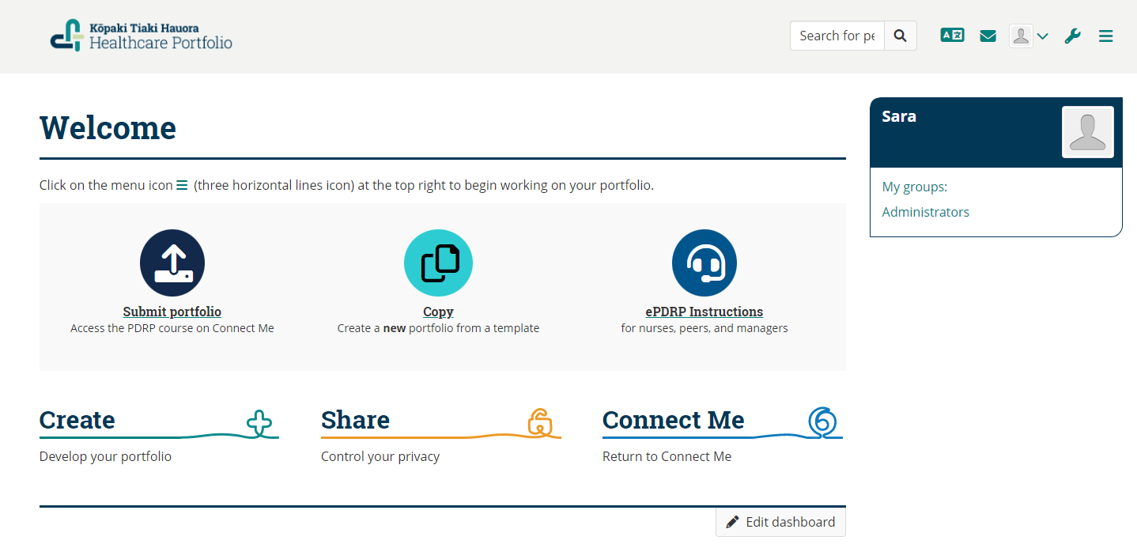
Healthcare portfolio homepage

Slide 19



Step 6
Once you are in the Healthcare e-portfolio homepage please click the envelope icon in the top right corner

Slide 20
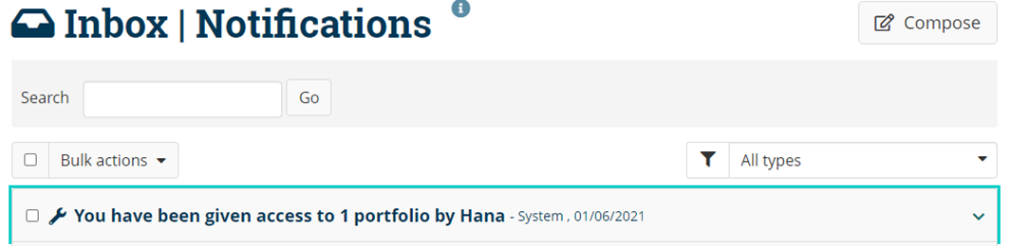

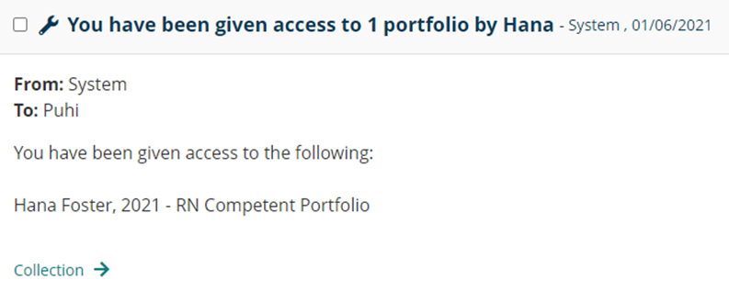
Step 7
A message like this will appear click on the inbox message
Then click Collection

Slide 21
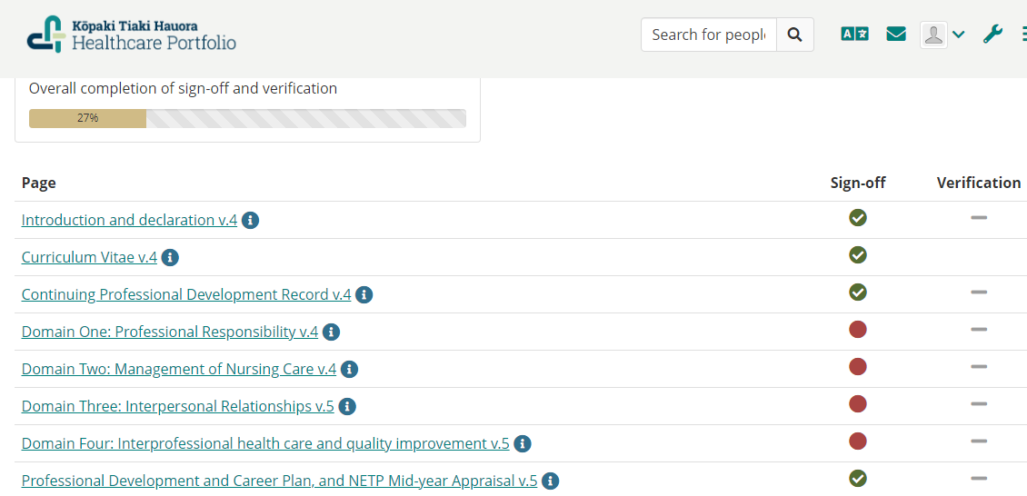
E-PORTFOLIO SHARED
After clicking collection this will take you to the portfolio shared with you. From here you can start going through the shared portfolio pages.
When you receive the portfolio all pages EXCEPT for the domain pages should be signed off (green ticks under sign off)
If the nurse signs off the domain pages you will not be able to add your peer assessment. The nurse only signs off the domain pages once the peer assessment is finished and before it is sent to the manager for verification.
Verification of the portfolio is the final step completed by the manager – peer assessors do not need to worry about this

Slide 22


How to add a peer assessment
Click on the domain pages to start adding in your peer assessment
Under each competency next to the self assessment section there is a peer assessment section
Click the Add peer assessment icon
Add your example to the paragraph block section please state the indicator you will answer, followed by your example e.g. Indicator A: how does the nurse meet this example......
You can either save your example as a draft and come back and complete at a later time (the portfolio holder will not be able to see this ) OR if you have finished writing your example you can click Publish and the portfolio holder will be able to see this.
To edit your peer assessment from draft or published go back to your example click the pencil icon to edit or the rubbish bin icon to delete
If you find that the nurse needs to provide additional information to meet the example provided in their self-assessment you can add this feedback to the peer assessment block and publish for them to see. Once the changes have been made and you agree that it meets the indicator then you remove your feedback by editing the peer assessment section and removing your feedback.

Slide 23
Asking for additional information to meet portfolio assessment requirements
You can add your feedback asking for additional information in the add peer assessment block and publish this so that the portfolio holder can see this.
Once the changes have been made the nurse should inform you to review, once you are happy with the additional information to meet the performance indicator you can remove your feedback and leave your peer assessment.
Please note I do encourage you to also maintain verbal communication if changes are required. Make sure to discuss this with the nurse rather than expecting them to see you feedback.

Slide 24
Helpful ways to start your examples:
information about what the nurse does, e.g.
I have observed Nurse X.....doing what
Nurse X communicates/assesses/precepts effectively by ..... doing what
Nurse X meets the indicator by ..... doing what
Nurse X has completed the learning package on direction and delegation
..then HOW Nurse X does it...
How do they do what they do – both in behaviour and in action, e.g.
Nurse X has completed the learning package on direction and delegation. She uses the 5 rights of delegation to delegate safely and effectively and always considers the scope or role, skill mix and patient acuity before delegating. When providing direction, Nurse X is supportive and encouraging of others to learn new skills.

Slide 25
Friendly reminder
The Capital & Coast PDRP programme is approved by NCNZ and therefore completion of the requirements provides exemption from recertification audit by Nursing Council.
It is a NCNZ requirement for approved PDRP programmes that nurses have two assessments against the competencies for their scope of practice every 3 years.
Therefore, as a peer assessor, information about how you know that the nurses practice meets the selected indicator from each competency, and specific examples of what the nurse does to meet each indicator is required.

Slide 26
Peer Assessment Completed
Once the peer assessment is complete:
The portfolio holder will be able to see this however please also let them know that you have completed your peer assessment
The portfolio holder will then sign off the domain pages once peer assessment is complete and confirmed by the peer assessor
The next step is for the portfolio holder to share the portfolio with the Team Leader to verify and endorse the portfolio.

Slide 27
If you require further support please contact the Nurse Coordinator Professional Development

