Slide 1

Pacific health

Slide 2
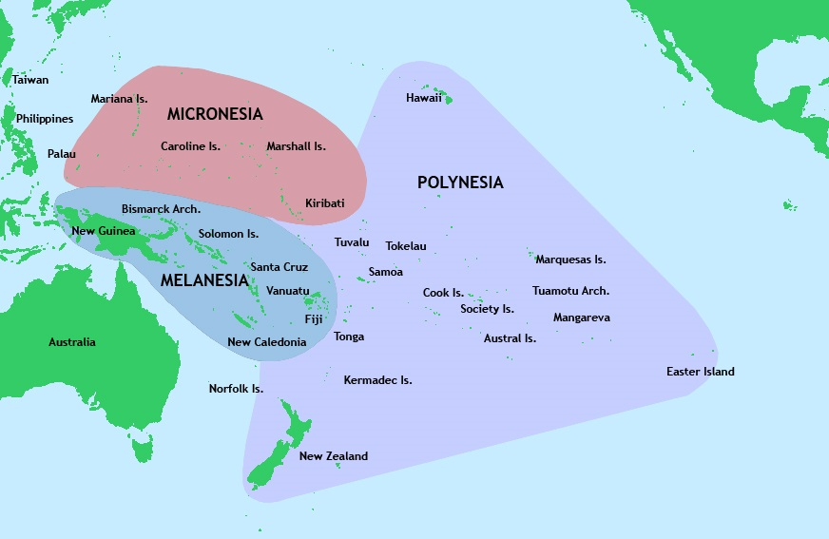
Pacific migration
https://www.youtube.com/watch?v=qibV_Hq0S_s

Slide 3
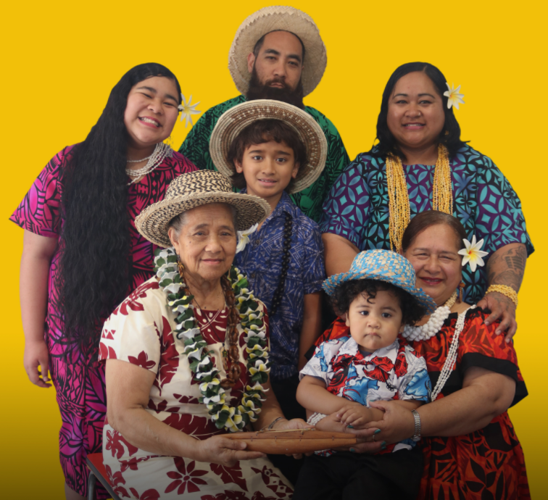
Understanding Pacific peoples
Pacific peoples’ is a collective term used in Aotearoa New Zealand to recognise the diversity of nationalities, ethnic groups and languages of people deriving from the Pacific Islands. It relates to a population made up of more than 16 culturally and linguistically distinct ethnic groups.

Slide 4
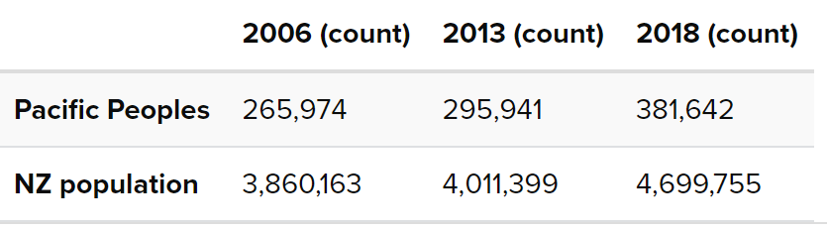
Pacific peoples in aotearoa New Zealand (2018, census)
9 Main Pacific ethnic group | Population in Aotearoa NZ
Samoan | 182,721
Cook Island | 80,532
Tongan | 82,389
Niuean | 30,867
Tokelauan | 8,676
Fijian | 19,722
Tuvalu | 4,653
Kiribati | 3,225
Solomon | 777
381,642 Pacific peoples
Youthful population – over 1/3 is under 15 years, median age 23.4 years
Increasingly diverse - NZ vs Island born, multi-ethnic
Highly urbanised, 66 percent of population live in the Auckland region
Rapidly growing
Notes:
Sub Region population

Slide 5
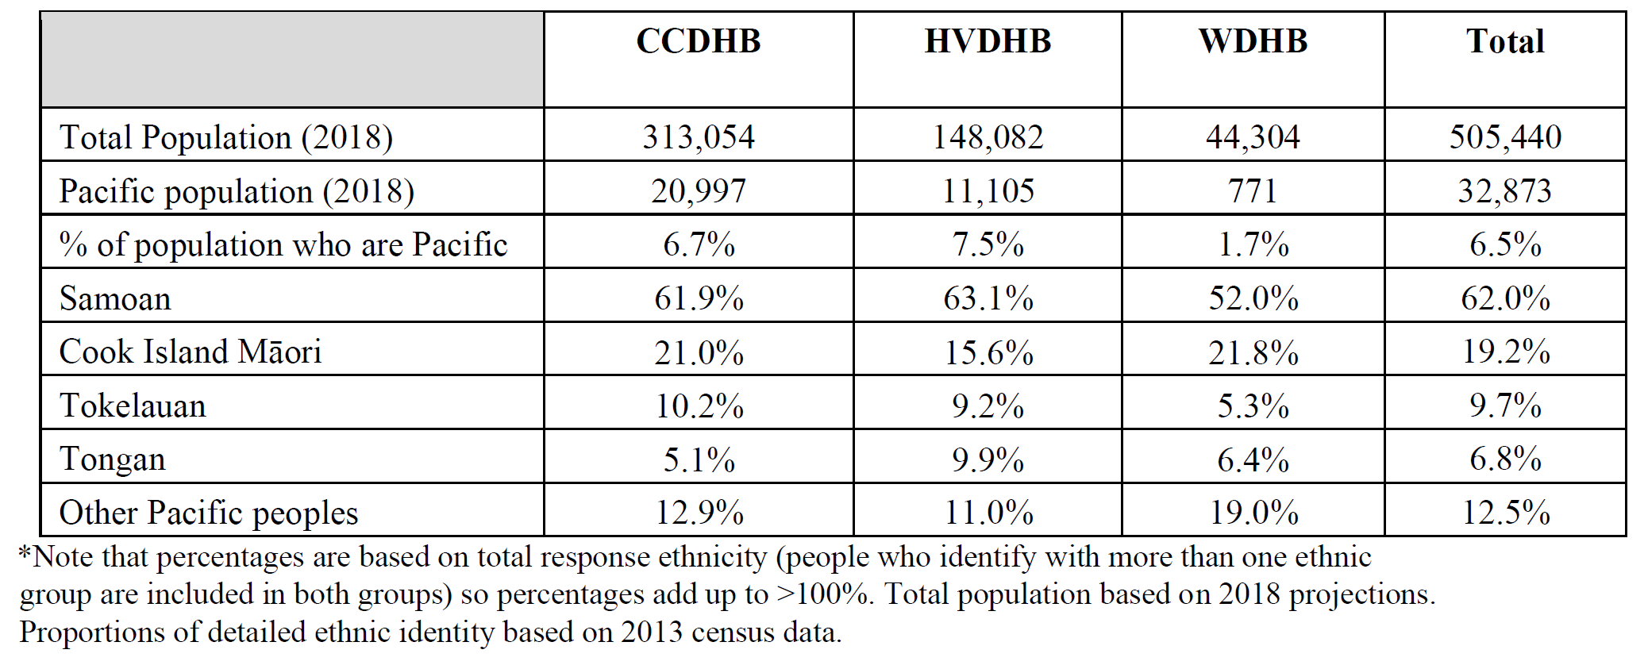
Pacific population wellington (2013)

Slide 6
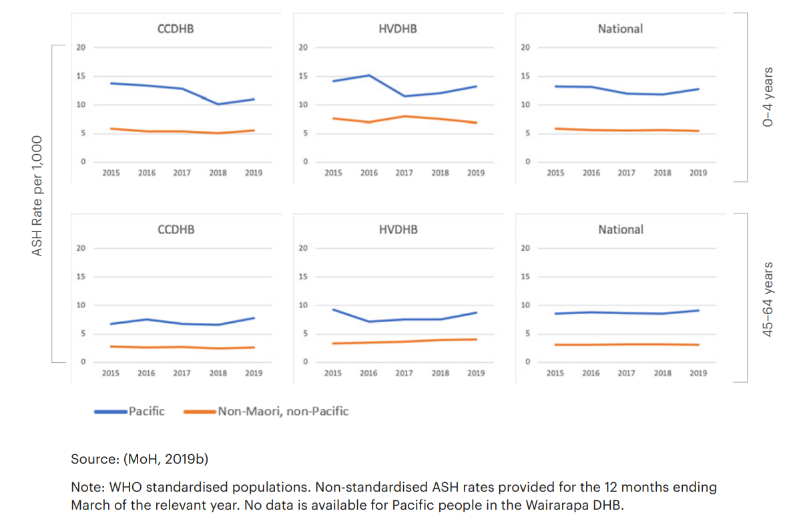
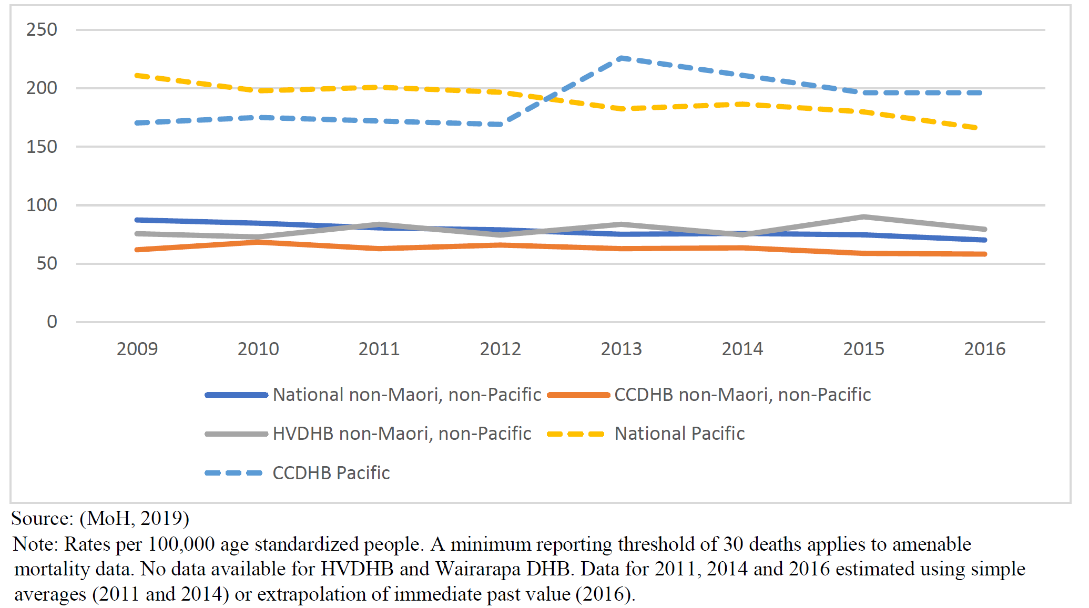
Pacific health 2dhb
ASH RATES BY DISTRICT HEALTH BOARD, 2015–2019, BY ETHNICITY
AMENABLE MORTALITY (2009 TO 2016), BY ETHNICITY AND DHB
Notes:
Pacific peoples face socioeconomic and health disparities and is overrepresented in poor wellbeing statistics across the board
- Pacific people in the CCDHB region have amenable mortality rates three times higher than that of non-Māori non-Pacific people (189.4 versus 62.8 per 100,000 people). Between 2009 and 2016, the amenable mortality rate for Pacific people increased by 15.2%, while the rate for non-Māori non-Pacific people fell by 5.9%.
• In 2015-17, the average life expectancy for Pacific people was 76.1 years, 7.9 fewer years than non-Māori non-Pacific people. This gap in life expectancy has not decreased over the last 10 years.
• More than 2,000 Pacific children in the region were considered to have excess body weight and 3,200 Pacific adults were current smokers.
• More than 50 Pacific children aged 24 months had not received their age-appropriate immunisations.
• 580 Pacific children had not been examined by community oral health services, and there were approximately 160 Pacific children aged five years with evidence of dental decay.
• Around one in eight (11.8% or 1,700) Pacific adults in the CCDHB region have diabetes compared to 4.4% of the total population. Of these Pacific diabetics, 740 do not have optimally managed HbA1C levels.
• 1,300 Pacific adults have not had a cardiovascular risk assessment.
• 30% of Pacific adults in CCDHB and 60% in HVDHB report unmet need for primary care in the last 12 months.

Slide 7
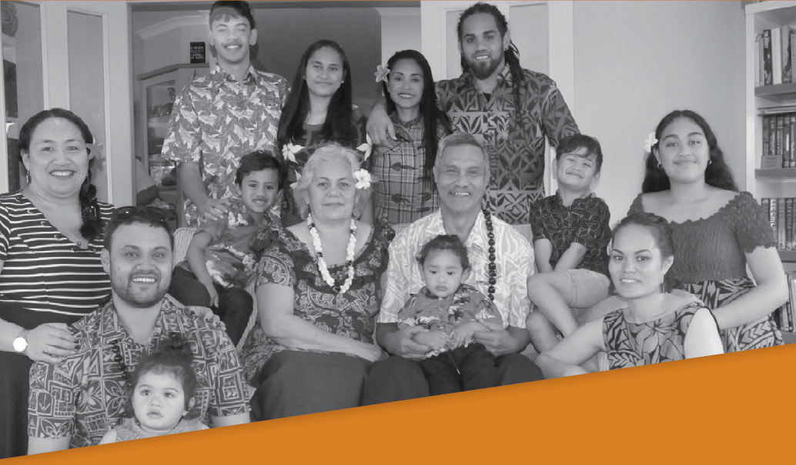
Pacific cultural values
Family values
Language
Cultural protocols and practices
Complex family Structures/arrangements
Cultural protocols
Spirituality/Religion
Traditional healing practices

Slide 8
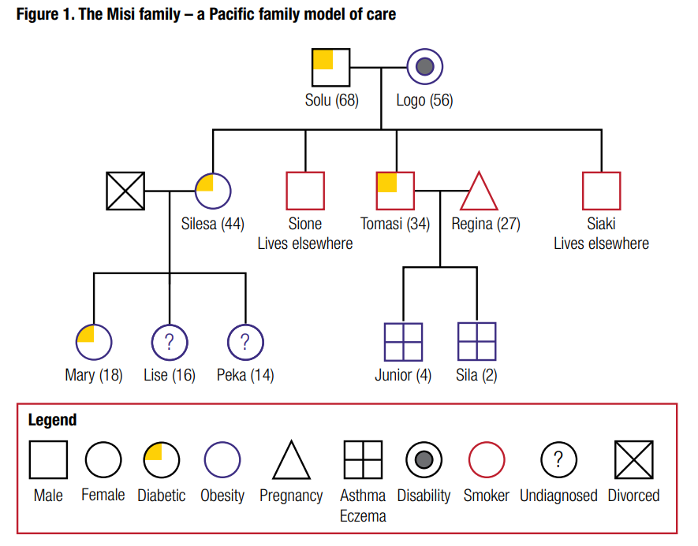
Case study – the misi family

Slide 9
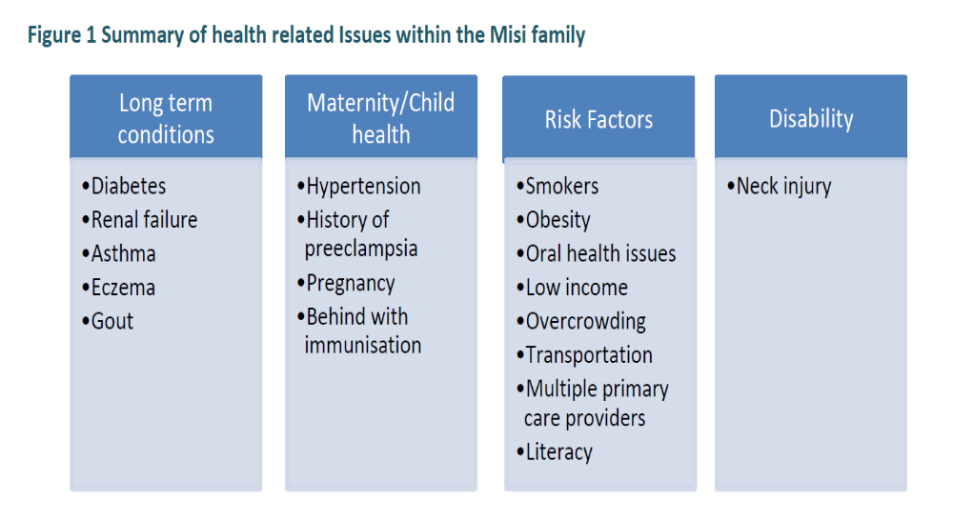
Situations for the Misi family is a reality for some Pacific families in high deprivation areas. It also reflects the strong correlation between socio-economic status as determinants of health and health outcomes.

Slide 10
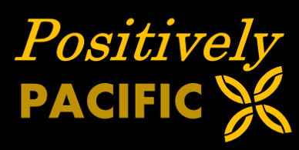
CCDHB Pacific health unit
What we do:
Advocacy
Health information & education
Referral to community and social service providers
Advice to inpatient services
Support with complex cases
Level 2, Cultural Centre
Wellington Hospital
Phone: (04) 806 2320
Email: PHUReferrals@ccdhb.org.nz
8.30am – 5pm, Mon - Fri
Referral forms available on the intranet

Slide 11
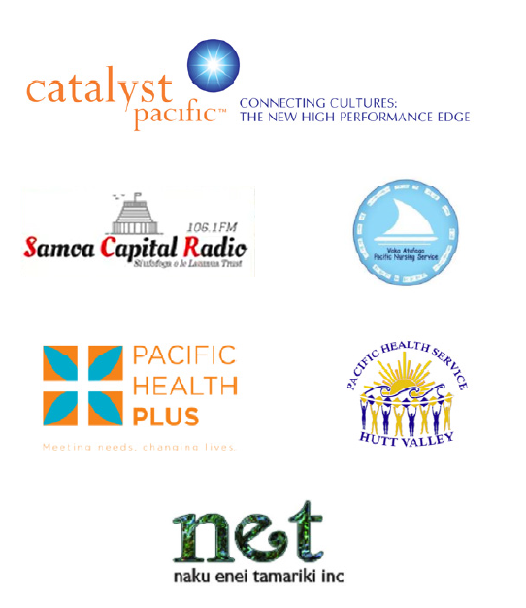
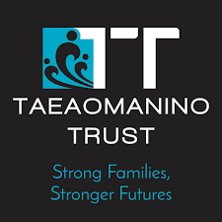
Pacific health providers
Catalyst Pacific Limited Communicating with Pacific Communities – Radio
Naku Enei Tamariki (Hutt Valley)
Pacific Health Service Hutt Valley (Hutt Valley)
Pacific Health Plus (Porirua and Wellington)
Taeaomanino Trust (Porirua)
Vaka Atafaga Pacific Outreach Nursing Service (Porirua)
Vaka Tautua Wellington Branch (Porirua & Wellington)

