Slide 1
Pacific Health
Presentation to Year 3 Nursing students

Slide 2
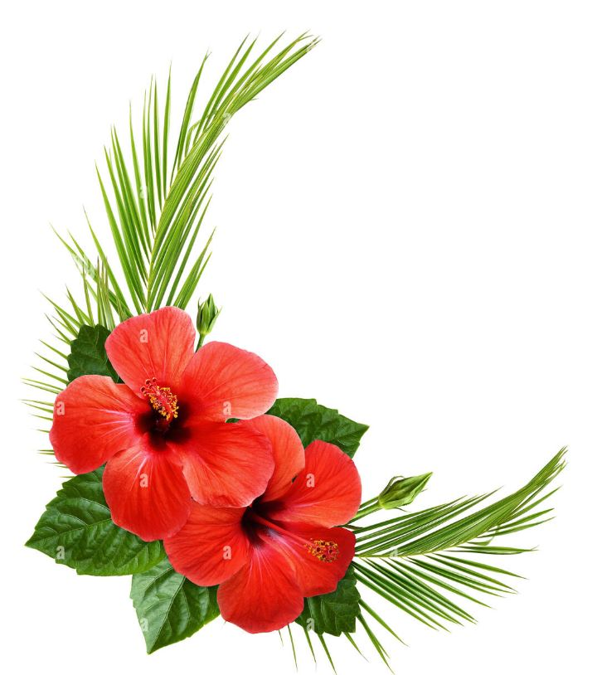
Warm Pacific Greetings
Talofa lava Samoa
Malo e lelei Tonga
Malo ni Tokelau
Fakaloha lahi atu Niue
Talofa Koutou Tuvalu
Mauri Kiribati
Kia Orana Cook Islands
Ni sa bula vinaka Fiji

Slide 3
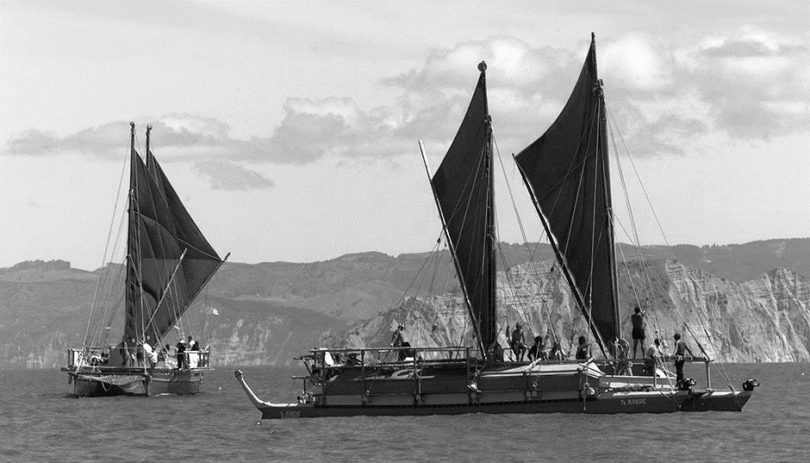
The Pacific Migration
https://www.youtube.com/watch?v=qibV_Hq0S_s
Notes:
Historical context for how Pacific people came to New Zealand

Slide 4
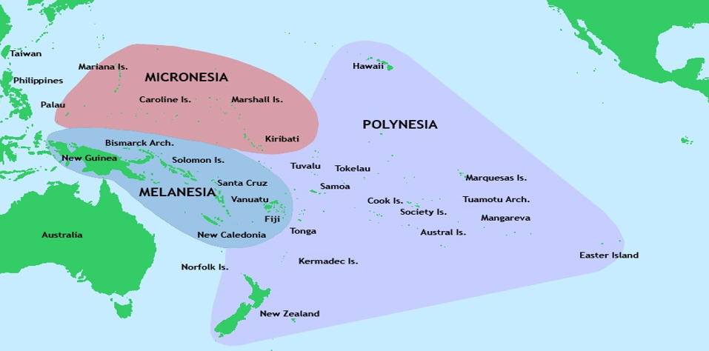
South Pacific
Notes:
.

Slide 5
Pacific people in New Zealand
2018 Census
Samoa 182,721
Cook Island 80,532
Tonga 82,389
Niue 30,867
Fiji 19,722
Tokelau 8,676
Tuvalu 4,653
Kiribati 3,225
Solomon 777

Slide 6
Priority Areas

Slide 7
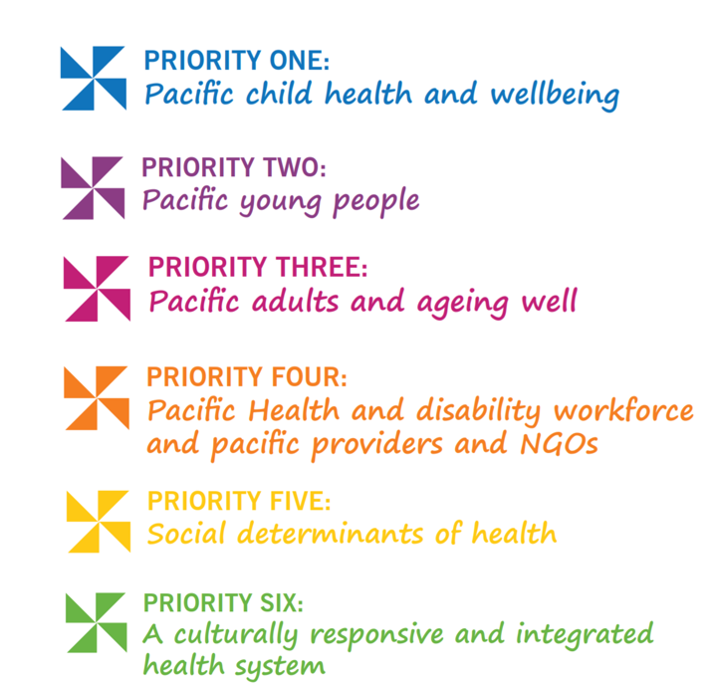

Slide 8
Pacific Health Unit (PHU) Wellington
Wellington Hospital
Ground Floor, Cultural Centre
Wellington Hospital
Phone: (04) 806 2320
Email: PHUReferrals@ccdhb.org.nz
8.30am – 5pm, Mon - Fri
Referral forms available on the intranet

Slide 9
Pacific Health Unit (PHU) Hutt Valley
Pacific Health Unit
Ground floor
Hutt Hospital
Phone (04) 570 9770
Email: pacificunit@huttvalleydhb.org.nz
8:30am – 5pm, Mon – Fri
Referral forms available on the internet

Slide 10
How the PHU supports Pacific inpatients
We advocate for all Pacific patients during their stay in the hospital
We support patients and their families with interpretation to help them understand their health issues and the health system
We facilitate links between hospital services and primary health care and community based services
We provide support to treating teams to assist them to understand how to work with Pacific patients & their families

Slide 11
Pacific cultural values
Family and Va relationships, Kin connections
Respect for the elderly
Reciprocity
Language
Cultural traditions
Spirituality/Religion
Traditional healing

Slide 12
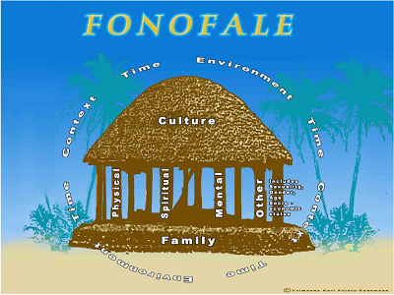
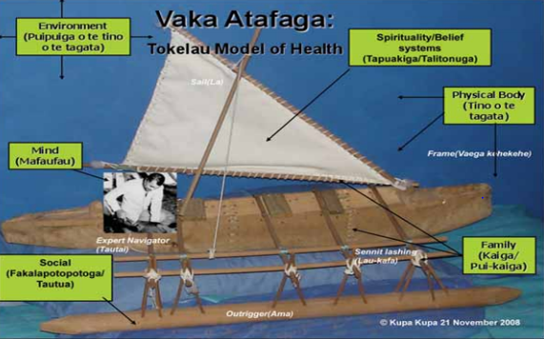
Pacific Models of Care
Fonofale Model
Samoan Fuimaono Karl Pulotu-Endemann
Vaka Atafaga Model
Tokelauan Kupa Kupa

Slide 13
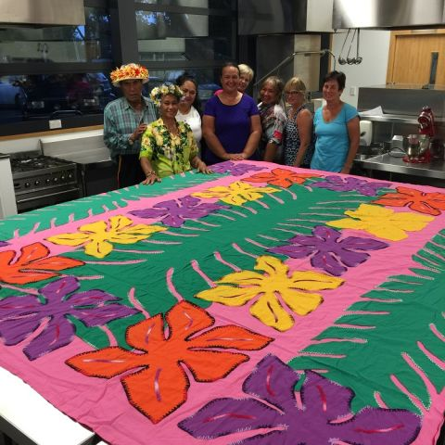
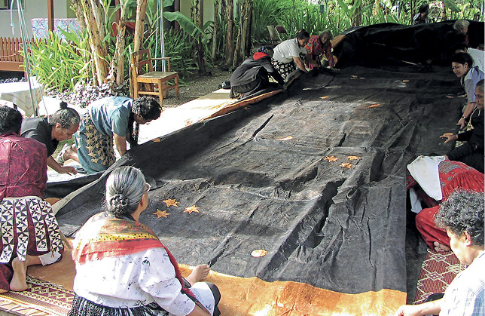
Pacific Models of Care
Tivaevae Model
Cook Island Teremoana Maua-Hodges
Toulanganga Model
Tongan Maile Feletoa Finau Uluvae

Slide 14
Fa’afetai lava / Malo ‘aupito / Fakafetai lahi / Fakaaue lahi / Fakafetai lasi /
Ko rabwa / Meitaki / Vinaka

