Slide 1
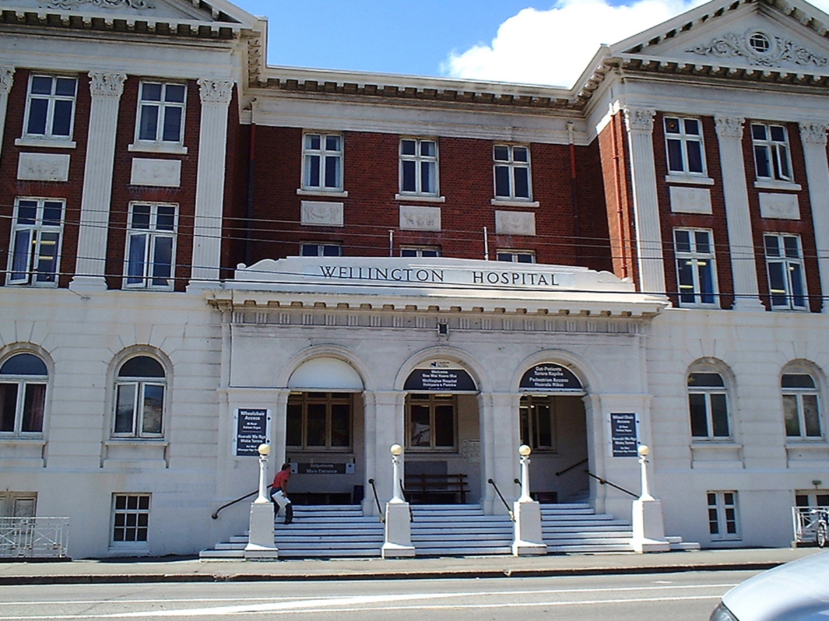

STUDENT ORIENTATION TO CCDHB & HVDHB
Notes:
Welcome and talk about how the DHBs have progressed over the years with new buildings and processes but our core business is people and that doesn't change

Slide 2
Maximising the Experience of Clinical Placement
Aim & Content
People
Places
Policies & Procedures
Familiarise & / or increase knowledge of access to
Professionalism In the workplace
Dedicated Education Units CCDHB
Security access and ICT
Parking
At CCDHB & HVDHB
Notes:
The aim of this day is to familiarize you with the DHB environment to make it feel a little less intimidating
Next Slide: Nursing who's who

Slide 3
Placement Information
Clinical Placement Information
CCDHB Website
Hutt Valley DHB Website
Notes:
Note that the preferred contact method and contact details for each ward are now in the orientation handbooks for HVDHB and these are the details that should be used to contact the wards prior to placements. Please use these where available and not going through switchboard. Students must download and read these before the placement commences.

Slide 4

CCDHB VALUES

Slide 5
HVDHB VALUES
Always caring- respectful kind, helpful
Can do- positive, learning and growing appreciative
In partnership- welcoming, listens communicates, involves
Being our best- innovating, professional, safe

Slide 6

Uniforms
Scrubs
Doctors (Teal)
Nurses (Navy) ED, NICU, Theatre, PACU
Midwives (Light Blue)
Theatres Sterile services (Grey)
At Hutt Valley DHB
Doctors & Nurses (Grey) - Theatres
ED CNS - Black
Notes:
If you don't need to wear scrubs in your clinical area you are to wear your TEP uniform. Scrubs are to be worn inside the hospital only and not to and from the hospital.
Next Slides :Pictures and places CCDHB (no HVDHB data ) An average day at CCDHB
New uniforms at CCDHB so there will be old and new around white or blue cross over tunic style

Slide 7
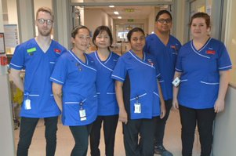

Slide 8
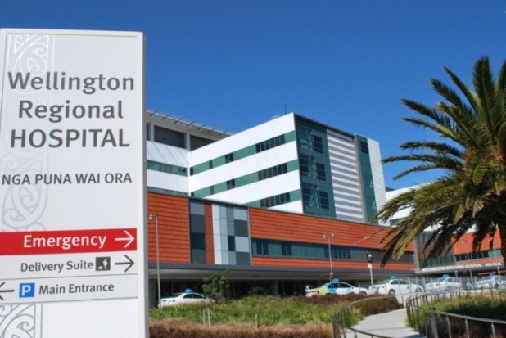
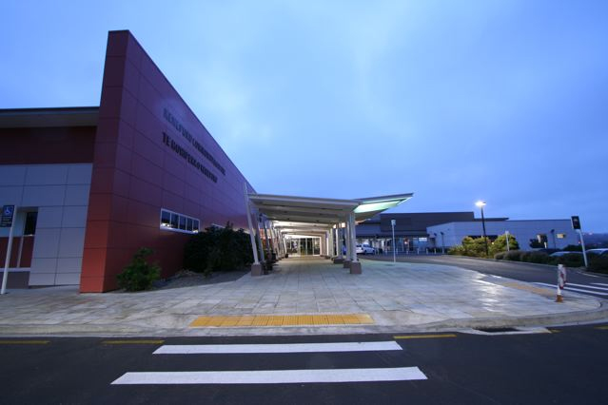
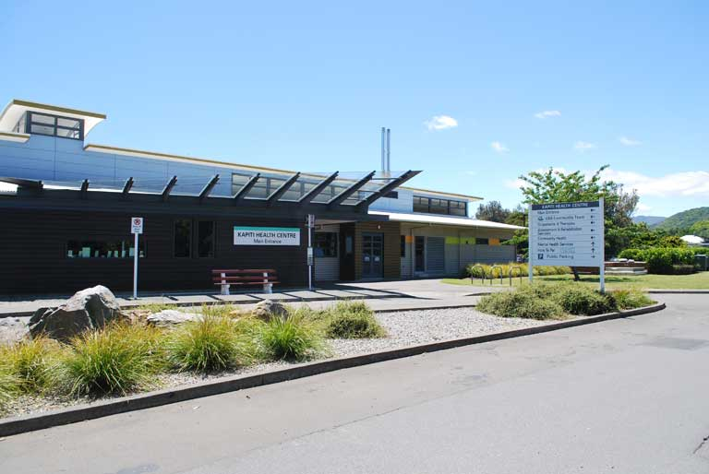
Places: CCDHB Wellington, Kenepuru and Kapiti
Notes:
CCDHB operates two hospitals – Wellington and Kenepuru and as well as the Kapiti Health Centre at Paraparaumu. There are also a number of community bases
The organisation serves about 250,000 people living in Wellington City and its suburbs, the Porirua Basin, and the Kapiti Coast including Waikanae. With about 3,200 full time staff and an annual payroll of more than $190 million, CCDHB is a major employer in the Wellington region.
Specialist tertiary-level care is provided to patients from the lower North Island and upper South Island, a population of about 900,000. These tertiary services include cardiology and cardiothoracic surgery, neurosurgery, vascular surgery, renal medicine and transplants, genetics, oncology, paediatric surgery, neonatal intensive care, obstetrics, endocrinology, orthopaedics and urology, and specialised forensic services.
Next slide a Year at CCDHB

Slide 9
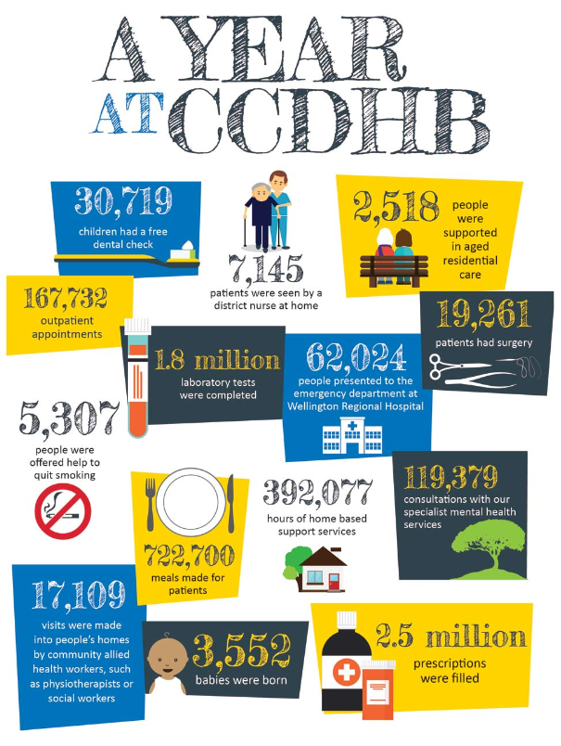
Notes:
Next slide HVDHB

Slide 10
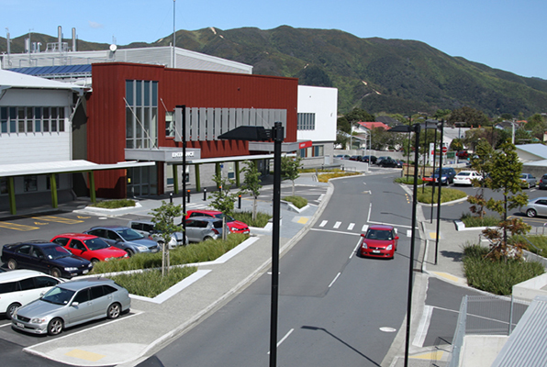
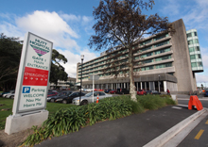
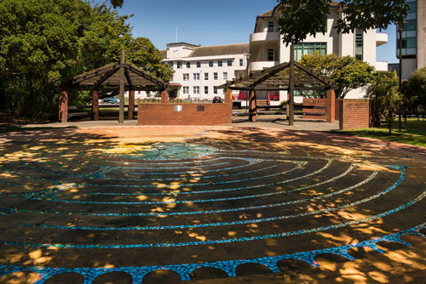
Places: Hutt Hospital
Notes:
Next slide Maps

Slide 11
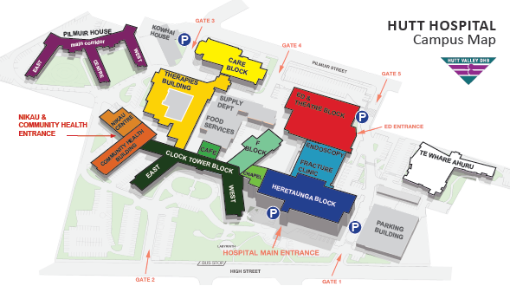
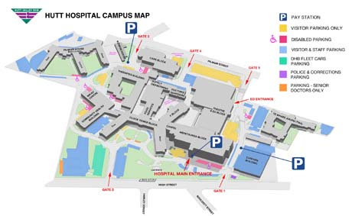
Maps of Hutt Hospital
Notes:
Next slide polices and procedures

Slide 12


Polices and Procedures
Notes:
The aim of this session is to familiarise and / or increase your knowledge of how to access our Policies & Procedures
To achieve this the content of this session will cover:
Why we have policies
What happens if we don’t have policies
What policies & procedures we have
Where they are found
Other resources
All units & departments have access via computers to polices and procedures
Next Slide: Other Where are they found on the intranet
This is to emphasise we obviously aren’t expected to know all of the policies in detail but you need to understand the format for ease of finding information when faced with a new situation that requires guidance.

Slide 13

Policies & Procedures

Slide 14
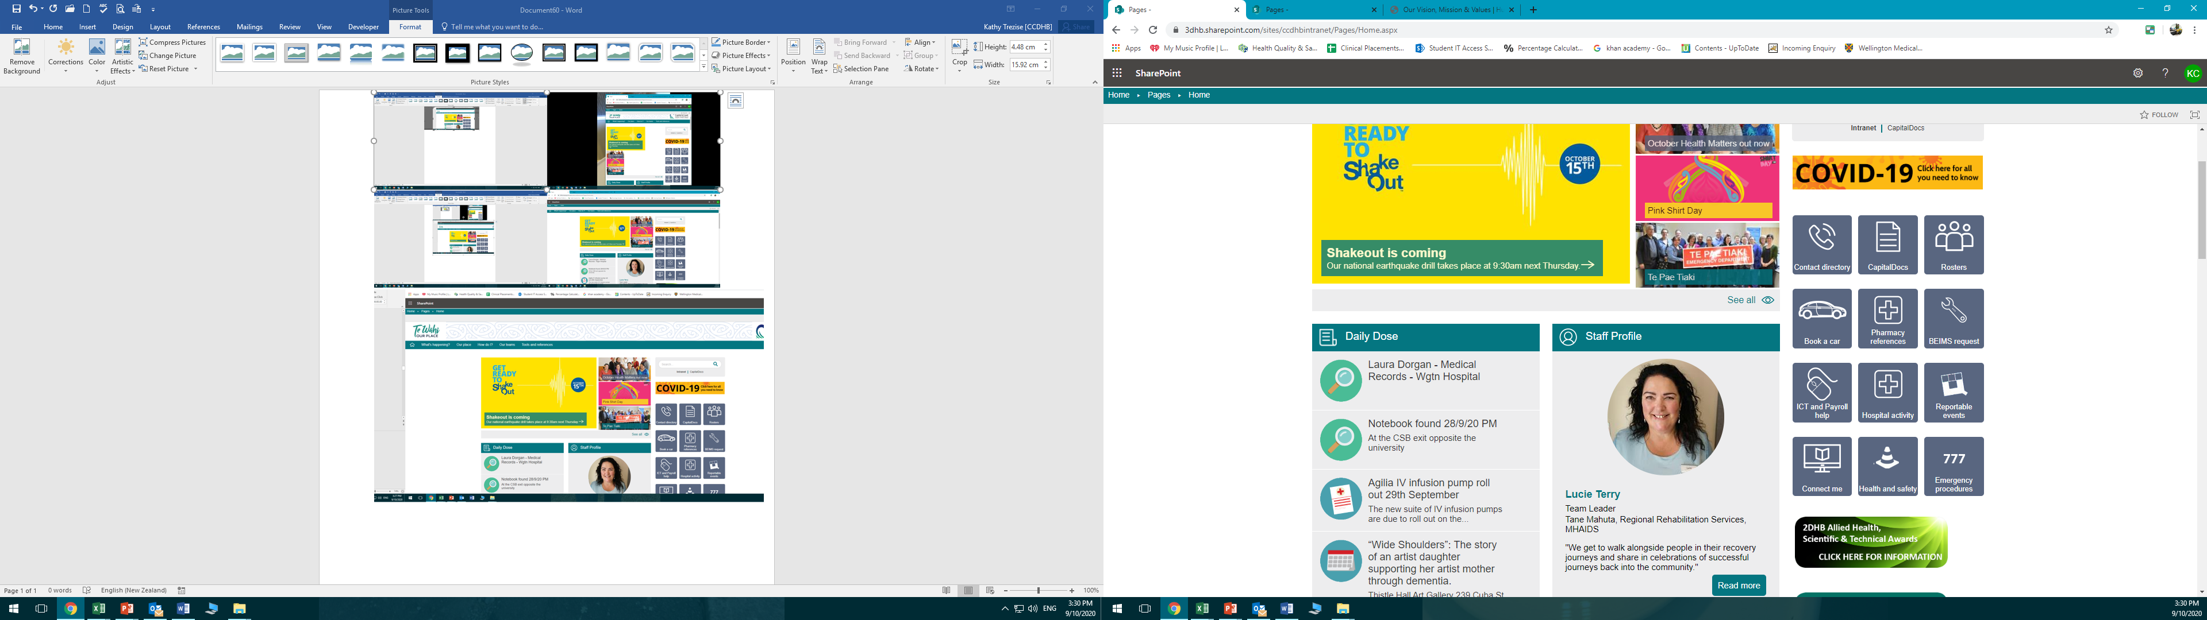
Policies & Procedures
Policies & Procedures
Notes:
Next slide : Professionalism

Slide 15

What is professionalism in the workplace?
Notes:
What is professionalism in the work place?
Confidentiality
Respect for clients and colleagues
Dress code, cleanliness and hygiene
Ready for work – look like and nurse and act like a nurse
Professional boundaries
Documentation coming prepared with learning objectives having visited the student web sites.
What does it look like?
Well dressed, tidy, appropriate clothing and footwear
How you talk, words you use, mannerisms
Respectful, right attitude, teamwork
Listening skills
Documentation: coming prepared with learning objectives having visited the student web sites
Next slide: What is unprofessional

Slide 16

What is not Professional
Notes:
What is not professional?
Disrespectful language
Using mobile phone
Untidy
Un-reported lateness and not turning up
Boundaries
NC code of conduct
Professional boundaries
Social media and the nursing profession (NZNO) Show booklets.
Next slide: DEU

Slide 17
Dedicated Education Unit
Clinical Learning Environment CLN
Tertiary ALN
Student Nurse
Clinical Learning Environment Clinical staff
Notes:
Next side student responsibility in DEU

Slide 18
Student Role in the DEU
Self-monitor progress toward achievement of the competencies for Registered Nurse scope of practice (New Zealand Nursing Council, 2012)
Take responsibility for their learning.
Obtain feedback from CLN, ALN and DEU staff.
Maintain communication with DEU staff regarding the patients'/clients health status.
Provide care consistent with the learning outcomes as outlined in the respective course requirements
Practice the skills of direction and delegation as appropriate.
Notes:
Next slide security access

Slide 19
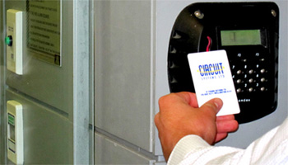
Security Access at the DHB
CCDHB has issued security access cards to Whitireia and Massey to enable students to be prepared for their placement
HVDHB Clinical areas may have security swipe cards for students. These are WHITE.
You are responsible for keeping these cards safe. Do not punch a hole on your card!
If it is lost or damaged return it to the designated administrator at Massey or Whitireia
Notes:
Next slide Computer access

Slide 20

ICT Access at the DHB
CCDHB & HVDHB now provide all second year students with ICT access during clinical placements.
You must attend a two hour training session
Provide your full legal name and declare if you have previously worked at either DHB in any capacity .
Access is provided to the concerto for patient records and lab results.
Outlook email to access the DHB E learning platforms.
Policies and procedures
Remember confidentiality
Notes:
Be familiar with
CapitalDOC & Intranet
Use of E-mailing and Texting
Use of Portable Devices
Social Networking
Health Information Privacy Policy
Privacy Act
Health Information Privacy Code
Security Access Agreement
Next slide: Parking

Slide 21
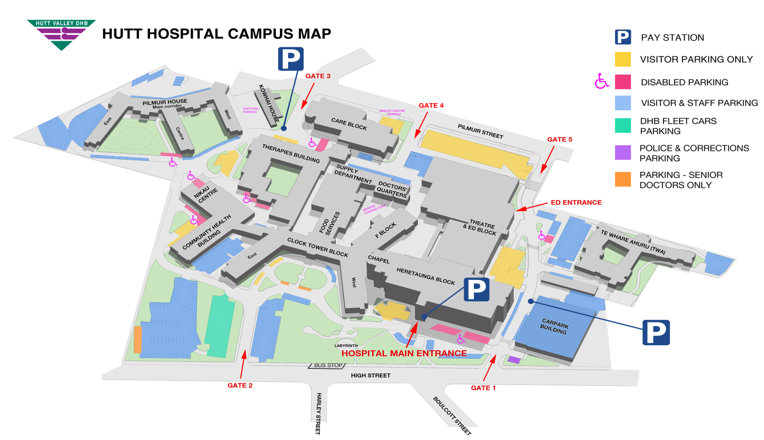
Parking
5 Minute walk from Epuni Rail Station
HVDHB offers discounted parking for students weekly pass $25
Parking
Costs:
$9 per day max.
Can park in roads surrounding hospital.
Buses stop here from Lower Hutt
Notes:
Be careful parking on roads surrounding the hospital as some are short stay parks and people can get fines etc
Students doing placements at HVDHB can go to the Parking Booth located on the ground floor just along the corridor from Endoscopy & Medical Day Stay (open Monday to Friday 08:00 to 19:00), where they can purchase a week pass for $25.”

Slide 22
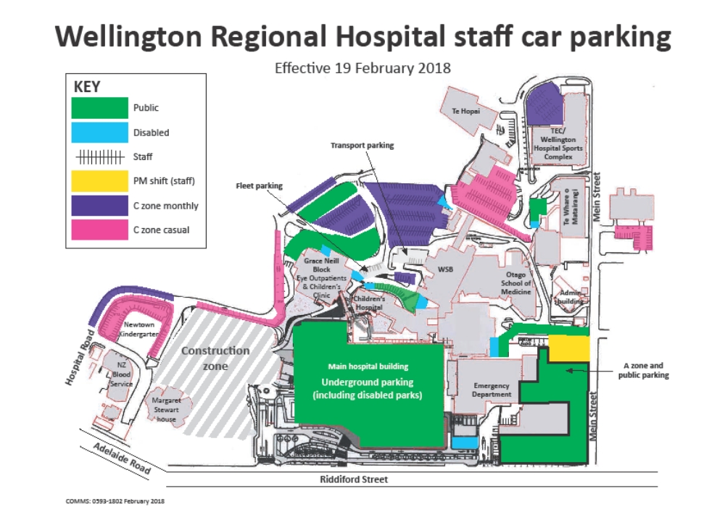
Parking Wellington
Parking
Cost:
$10 max per day
$6 max weekends you can no longer apply for a concession card see CCDHB student web site for details
Parking details
Notes:
Ride share
Professional and organized around start and finish times.
Buses let staff know in regard to evening shift if you need to catch buses
We are exciting to be building a new children hospital. This has let to changes in where and how you can park. Please check the CCDHB web site for details via the student web site.

Slide 23
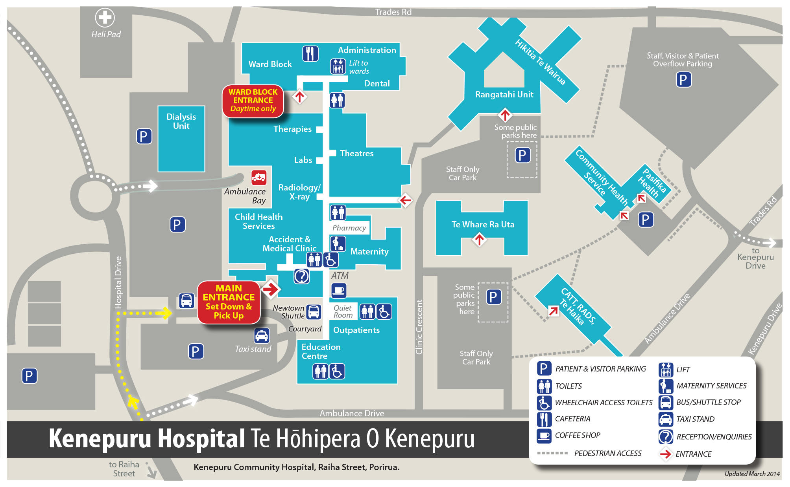
Parking
Cost-Free
Park in staff designated areas
Notes:
Next slide Questions the end !

Slide 24

CCDHB and HCDHB

