Slide 1

Infection, Prevention and Control
2nd year Nursing student 2022
IPC CNS
Karen Corban
Adriane Turner

Slide 2
Covid - how to keep safe IPC principles
Stay home if you are sick
Keep track of where you have been
Wear a face covering
Wash you hands or use hand sanitser
Cough or sneeze into the elbow
Clean or disinfect shared surfaces regularly
Improve ventilation
Keep you distance from people you do not know

Slide 3
Standard Precautions
Group of basic infection control measures that apply to all patients, all the time.
Includes:
Hand hygiene, PPE use, sharps safety, environment cleaning, waste disposal, linen management, cough etiquette, etc.

Slide 4
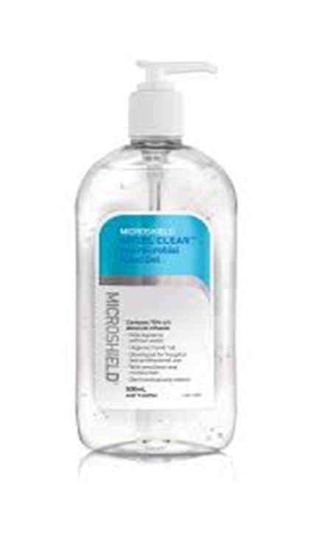
WHEN to do Hand Hygiene?
Before eating
After toileting
Entering and leaving workplace
5 moments of hand hygiene
Sanitiser or soap and water – which is better?
What if I am using gloves?
What hand cream and when?

Slide 5
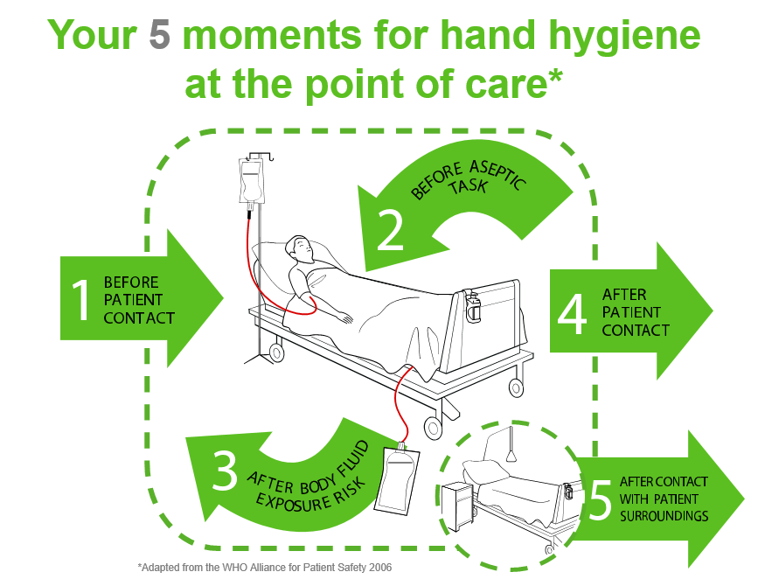

Slide 6
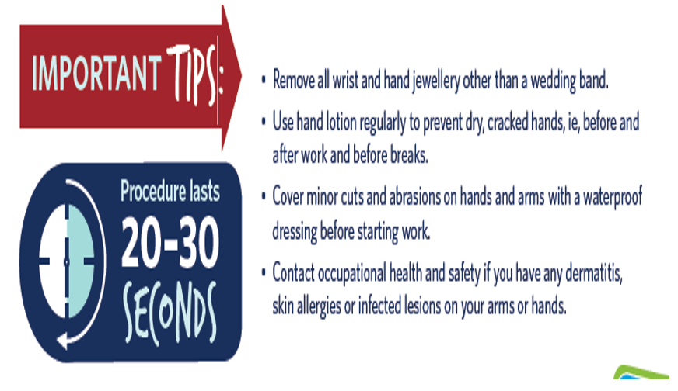
HH – How to

Slide 7
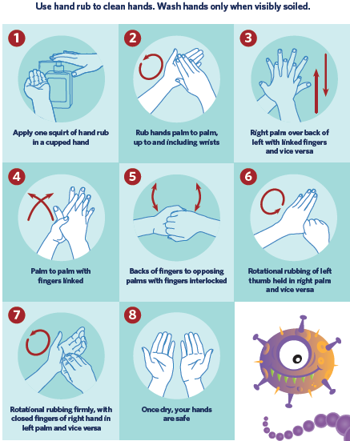

Slide 8
Cleaning patient equipment and the environment
What do we use to clean?
detergent wipes
When do we clean equipment?
between patient use. Store equipment clean
What equipment do we clean?
everything that a patient touches, that is not disposable. E.g. procedure trolley, IV poles and pumps
Who cleans the environment?
Cleaners. HCAs. Nurses

Slide 9
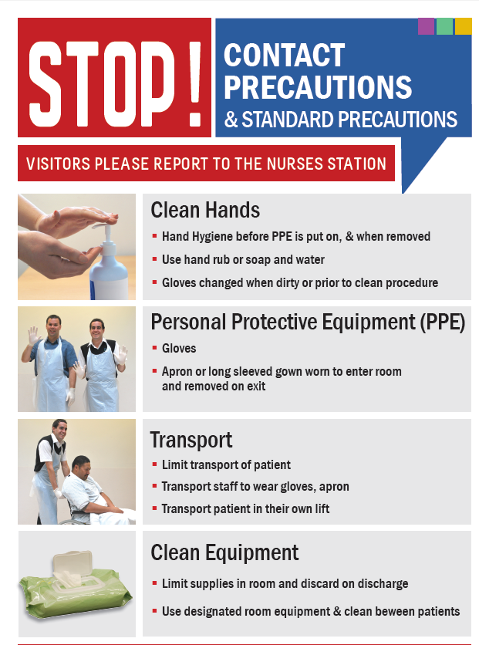
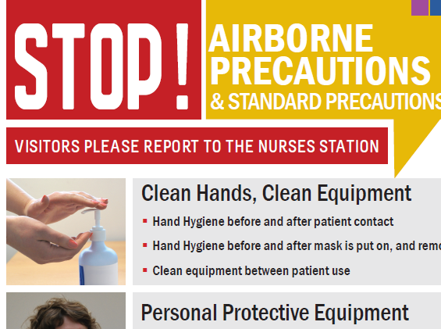
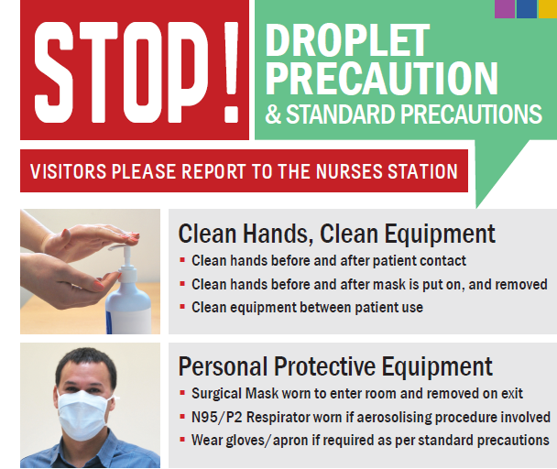
Transmission
based precautions
When standard precautions is not enough
These signs instruct staff about what to do: PPE, cleaning, transfers etc.
More information is available for staff on the back of sign.

Slide 10
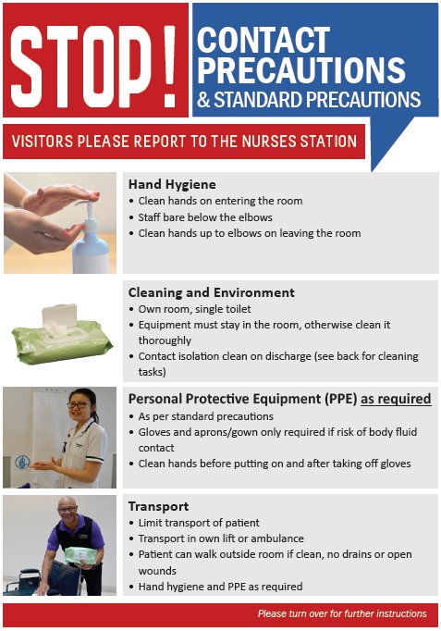
For whom?
D+V, bad skin condition
Some diseases eg scabies
Some MDROs
Overseas in last 12 months
What is the most important thing?
Hand hygiene
What else is important?
Cleaning equipment
Discharge iso clean
Own toilet
When to use PPE?
Risk of blood or body fluid contact

Slide 11
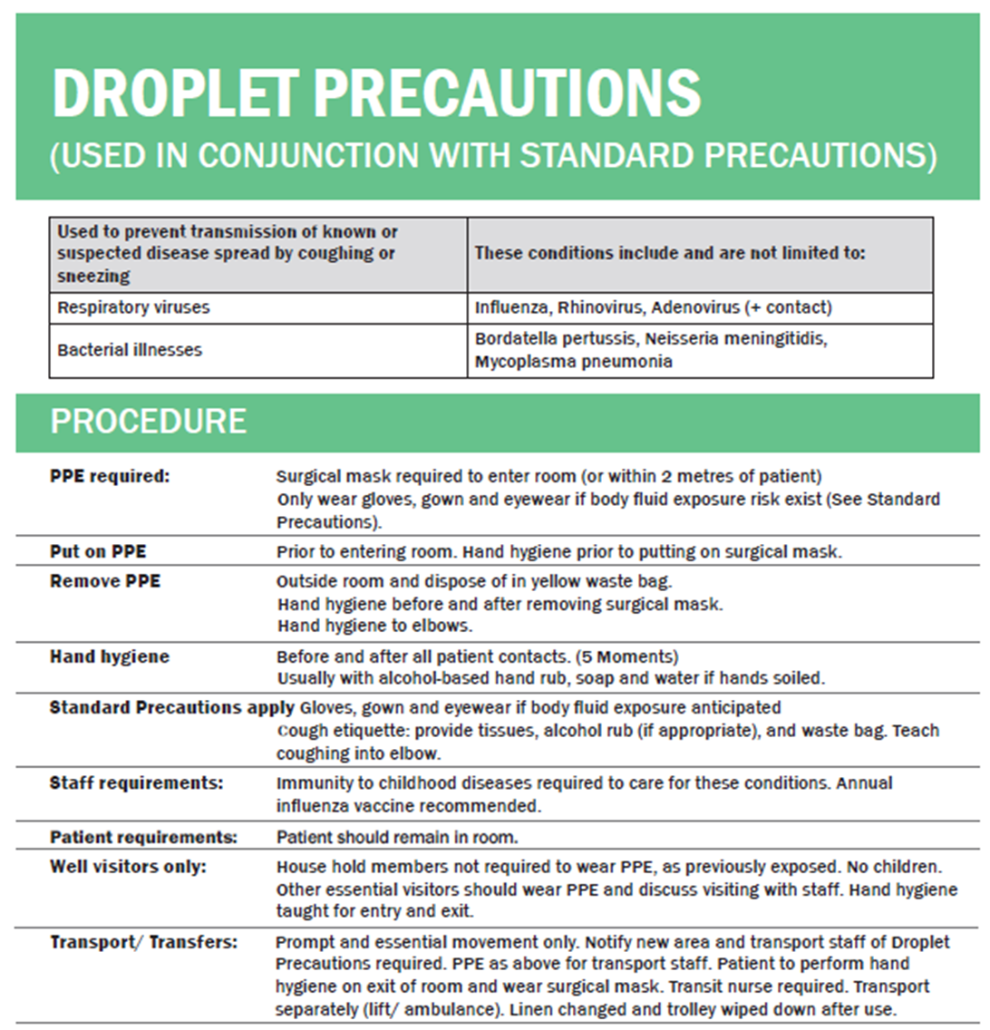
Droplet Precautions
For organisms spread from coughs and sneezes e.g. colds and flu
Key elements:
Surgical mask be worn to enter the room and for transport.
N95 mask to be worn if patient on nebulizer or NIV.
Control spread of cough/sneeze

Slide 12
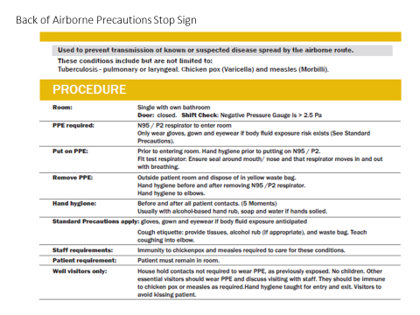
Airborne Precautions
For organisms we breathe out e.g. TB, chickenpox, measles
N95/ P2 respirator worn in the room and for transport by staff.
Negative pressure room.
Doors closed.

Slide 13
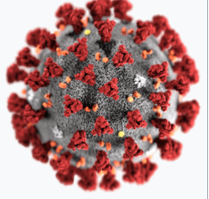
Covid-19

Slide 14
Working in a hospital during covid
How to keep safe – is all about the mask
Its all about the mask
  seal check
  sanitise hands if any breech
  change if soiled
MUST Wear a mask at all times
Do not eat or dink in clinical spaces
Tea room highest risk for all staff– tea room etiquette
Do not come to work unwell

Slide 15
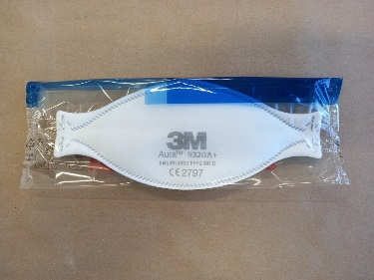
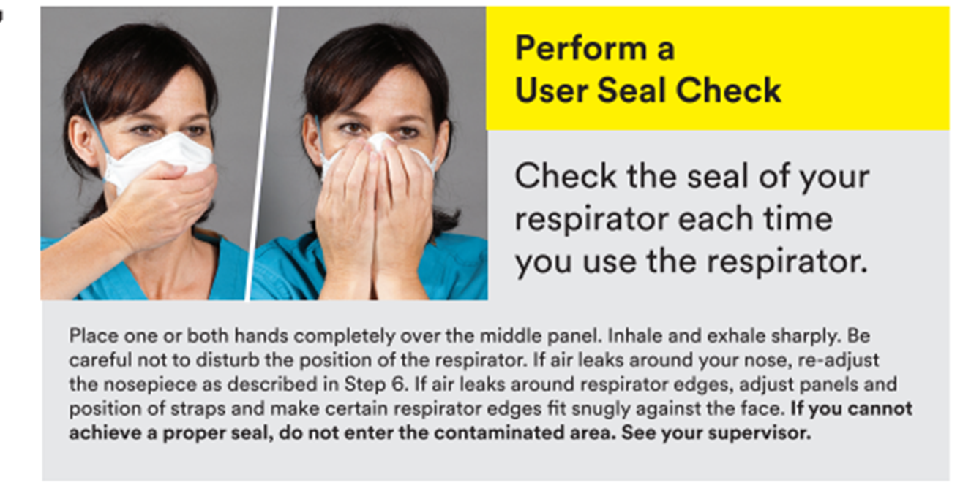
N95 respirators
Wear a fit checked N95/ FFP2 respirator for all probable/confirmed Covid-19 care.
Seal Check each time you use a new mask

Slide 16
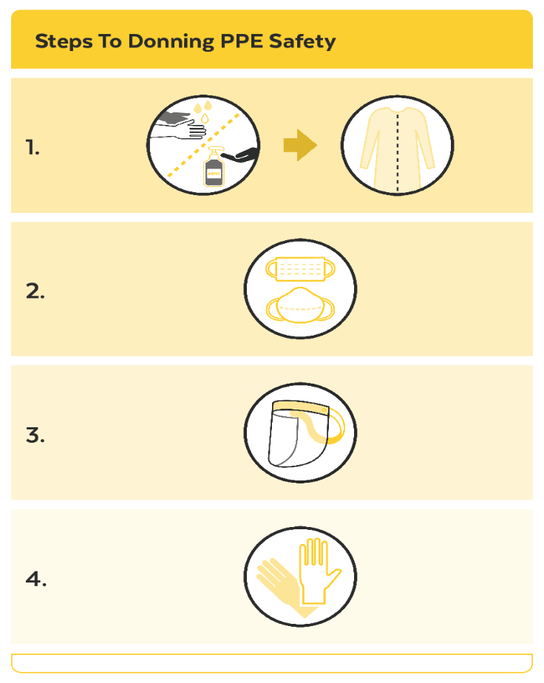
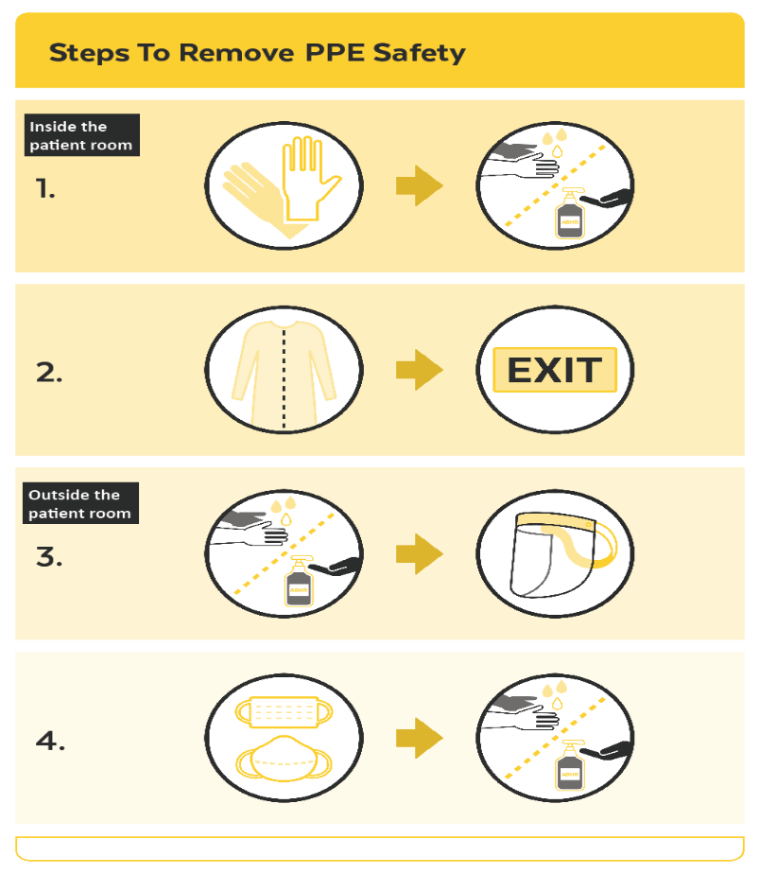
Donning and Doffing PPE in the Covid context
Notes:
Don:
0. You cannot do this with a watch or chunky rings on.
Alcohol gel kills Covid almost instantly, but we rub for 20 seconds to get good cover in all the nooks and crannies. Soap also kills Covid almost instantly, but we take 40 seconds to cover all nooks and crannies and dry effectively.
Securing at the hip means you can see the ties when you are taking it off, but it is not essential.
Demonstrate straps at neck and crown of head. If you can’t get a good seal, don’t go in the room.
Remove plastic film on both sides so it is clear.
We always sanitise before reaching into a glove box so we don’t contaminate the other gloves in the box. But here, you have sanitised at the beginning hand have only touched clean equipment, so it is okay. You may like to pull the cuffs low over your hands before donning gloves so you have a good overlap of gloves over gown. Do not make a hole by pushing thumb through the gown – this will mean you can’t do effective hand hygiene later.
That all is correct.
Doff:
The point is to not touch your hands with the outside of the glove. However, since contamination is always a risk, we do hand hygiene afterwards.
We want clean hands before reaching up to the back of our neck.
There are many techniques for removing a gown: arms crossed over, or sliding out of the sleeves. The important thing is that you take it off without the outside touching your clothes. Rolling the gown held out away from your body is the best way to do this. Put gown deep into rubbish bin. Do not leave it on the top, so that it is likely to overflow next time.
We will probably contaminate our hands taking off the gown. Everything in the room is considered contaminated, so we don’t need to clean our hands before leaving.
Sanitise now before touching anything else, and before toughing your hair.
Doffing N95 mask this way prevents it flicking around on the elastic in an uncontrolled way.

Slide 17
Any Questions
THANK YOU ☺

